Slide 1
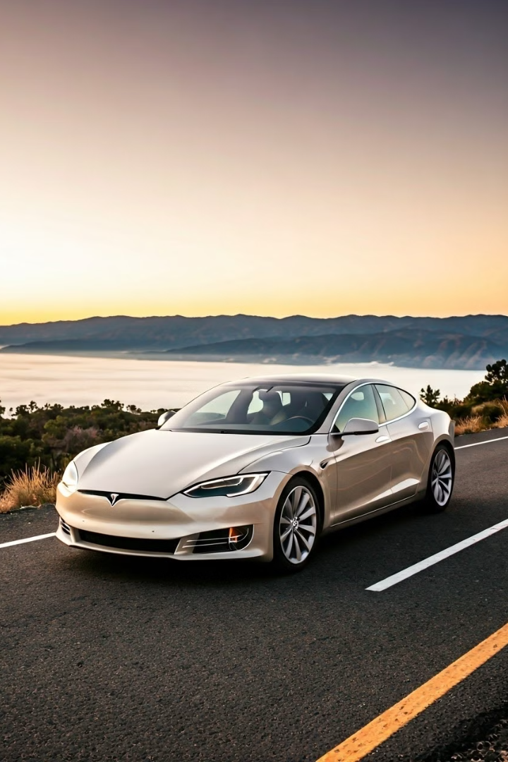
Tesla Stock Price Prediction
Analyzing Tesla's stock price is a complex task, as it is influenced by a variety of factors, from the company's technological innovations to broader macroeconomic trends. A comprehensive approach is needed to make accurate predictions about the future performance of Tesla shares.

Slide 2

Team Members 1. Kola Komala Sai 2. Sakha Abhiram 3. Chintakula Shankar Narayana
4. Kadimi Venkata Sai
5. Sheik Iliyas

Slide 3
Tesla's Position in the EV Market
Market Leader
Competitive Landscape
Innovation Advantage
Tesla has firmly established itself as the market leader in the electric vehicle (EV) industry, with a dominant market share and a reputation for cutting-edge technology.
However, the EV market is rapidly evolving, with traditional automakers and new startups alike entering the fray and vying for a piece of the pie.
Tesla's ability to maintain its technological edge and continue innovating will be crucial in determining its long-term dominance in the EV market.

Slide 4
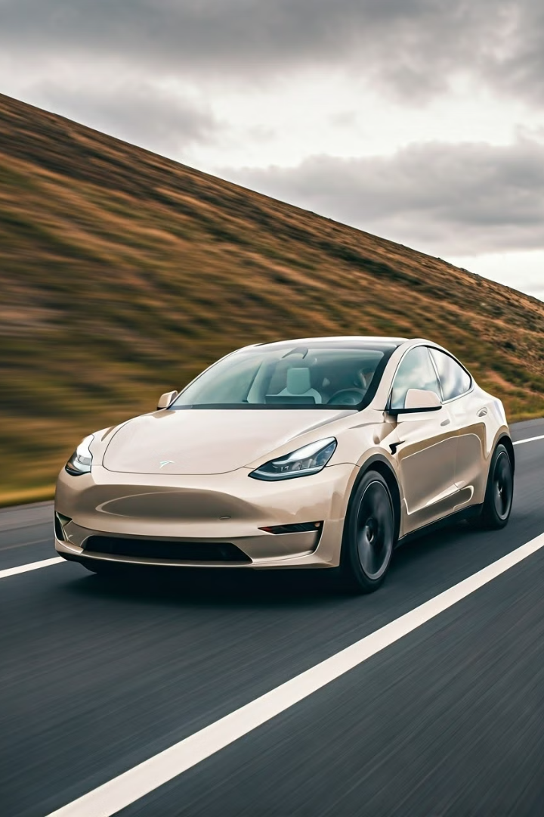
Key Drivers of Tesla Stock Price
1
Production Capacity
Tesla's ability to ramp up production and meet growing demand for its vehicles is a key driver of its stock price.
2
Autonomous Driving
The company's progress in developing autonomous driving technology and securing regulatory approval is closely watched by investors.
3
Energy Storage
Tesla's diversification into energy storage solutions, such as its Powerwall and Powerpack products, also impacts its stock performance.

Slide 5

Macroeconomic Factors Affecting Tesla
Interest Rates
Commodity Prices
Changes in interest rates can affect the affordability of Tesla's vehicles and the company's financing costs.
Fluctuations in the prices of raw materials, such as lithium and cobalt, can impact Tesla's production costs.
Government Policies
Macroeconomic Trends
Regulatory changes, such as subsidies or incentives for EVs, can significantly influence Tesla's market positioning and sales.
Overall economic conditions, consumer sentiment, and industry-wide trends can all affect the demand for Tesla's products.

Slide 6

Valuation Methodologies for Tesla
Discounted Cash Flow (DCF)
Analyzing Tesla's future cash flows and discounting them to present value.
Comparable Company Analysis
Comparing Tesla's valuation metrics to those of similar EV and technology companies.
Option Pricing Models
Incorporating the value of Tesla's growth options and future technological innovations.

Slide 7





Tesla's Innovation and Technology Pipeline
Battery Technology
Autonomous Driving
Advancements in battery density, charging speed, and cost reduction.
Continuous improvements in Tesla's Autopilot and Full Self-Driving features.
Renewable Energy
New Vehicle Models
Expansion into solar and energy storage solutions, such as the Solar Roof.
Development of innovative electric vehicles, including the Cybertruck and Roadster.

Slide 8




Regulatory Landscape and Tesla
Emissions Regulations
Autonomous Driving Rules
Government Incentives
Tesla's compliance with increasingly stringent emissions regulations is crucial for its continued growth.
The regulatory framework for autonomous vehicles will shape Tesla's timeline for Full Self-Driving deployment.
Policies supporting electric vehicles, such as tax credits and subsidies, can boost Tesla's sales and profitability.

Slide 9

My Github Repository
https://github.com/AbhiramSakha/Edunet-Project

Slide 10
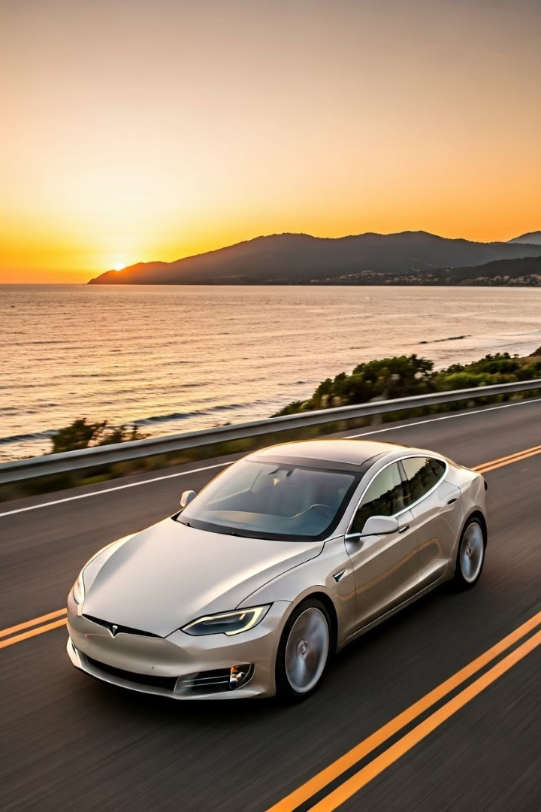
Thank You
Thank you for your attention. I hope this presentation has provided a comprehensive overview of the key factors influencing Tesla's stock price prediction and the company's position in the evolving electric vehicle market.

